Slide 1
CAN Tools
AGENDA
CAN Part in a ECU, Hardware + Software
CAN Frame parts which field is whose responsibility
Responsibility o Software and Hardware in a CAN setup
How a CAN testing Setup looks like
Basic Canalyser setup
Shyam Bhat
VicharaVandana

Slide 2
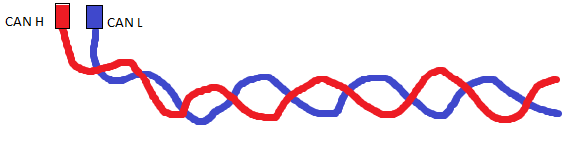
CAN Hw and Sw Parts
SOF
CPU
HW + SW
Msg ID
Application
RTR
Base SW + Configurations
Reserved
DLC
Via RAM and Registers
Driver SW
DATA
CAN Controller
Rx
Tx
CAN Transciever
CRC + CD
ACK + AD
CAN BUS
EOF

Slide 3
CAN Validation Basics
CAN Implementation in a company means implementing different frames. SO The details of what are the various Rx and Tx frames, Type, Which data it contains, how many data it has, Where are different data elements located etc are given in a document called Can Matrix. It can be a Com matrix or DBC file.
After these frames are realized in the ECU, it has to be verified they its implemented properly in an ECU. This process of Verification is called CAN Validation.
For doing this we need a CAN tool which can simulate another CAN node needed for testing. One such famous Testing tool is Canalyser from Vector.
Canalyser also has 2 parts: Hardware and Software. Here you can monitor the traffic on the bus and trigger various can frames.
Remember In the network for testing only 2 CAN nodes will be there. One is ECU which has to be tested and other is Canalyser which helps in testing.
The Tx frames for Canalyser are Rx frames for ECU and Tx frames from ECU are RX frames for Canalyser.

Slide 4
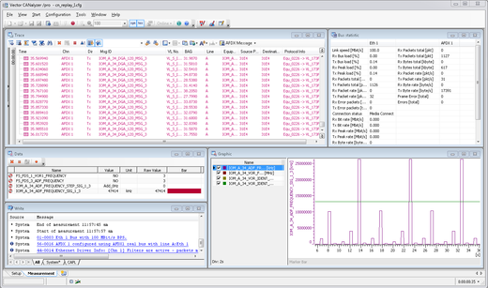
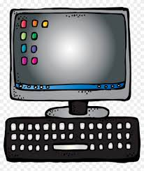
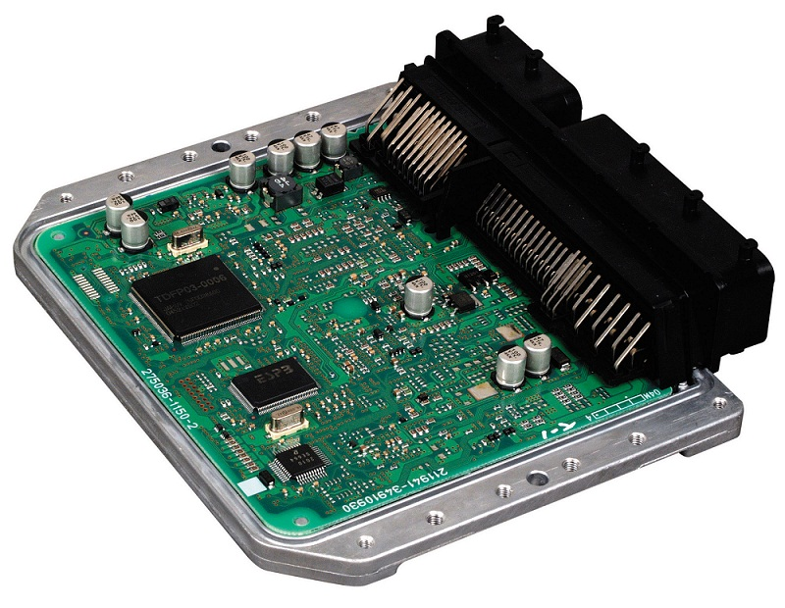
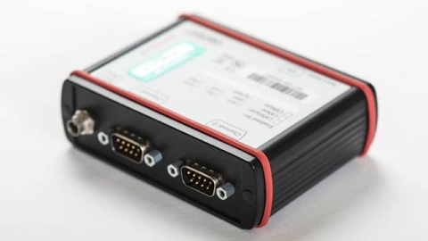
CAN Testing Setup
ECU Software Flashed to be texted
Canalyser Software
CAN

Slide 5


